Slide 1
Algebraic Fractions
EQ – How do we add and subtract algebraic fractions with different denominators?
Year 10

Slide 2
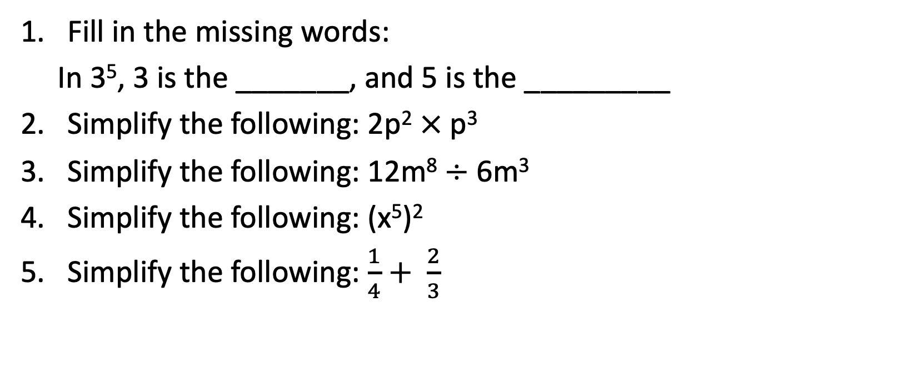
Five Questions (LHS)
Topic: Algebraic Fractions
EQ – How do we add and subtract algebraic fractions with different denominators?
Fill in the missing words:
In 3⁵, 3 is the _______, and 5 is the _________
Simplify the following: 2p² $×$p³
Simplify the following: 12m⁸ $÷$ 6m³
Simplify the following: (x⁵)²
Simplify the following: $\frac{1}{4}+ \frac{2}{3}$

Slide 3

Learning Intentions
Students will be able to
Define the steps taken to get a Lowest Common Denominator (LCD)
Apply LCD to algebraic fractions with different denominators
Add and subtract algebraic fractions with different denominators
WICOR

Slide 4
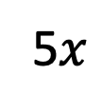



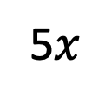
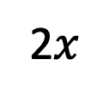



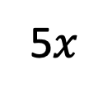



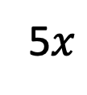


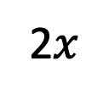





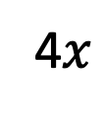


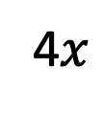


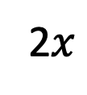


24
7
30
Algebraic Fractions
Date:
EQ – How do we add and subtract algebraic fractions with different denominators?
We can add and subtract algebraic fractions in the same way as numerical fractions. The key is to find a common denominator
Ex1
Work out:
Ex2
Work out:
Ex3
Work out:
2$x$
$x$
$x$
$x$
5$x$
2$x$
$+$
$+$
$−$
Solution
4
16
Solution
5
2
Solution
6
3
$x$
$x$
4$x$
$x$
2$x$
$x$
4$x$
5$x$
5$x$
2$x$
5$x$
4$x$
$+$
$=$
$+$
$+$
$=$
$+$
$−$
$=$
$−$
4
16
16
16
5
2
10
10
6
3
6
6
9$x$
Find a common denominator.
5$x$
Find a common denominator.
Find a common denominator.
$$x$$
$=$
$=$
$=$
16
5 $×$ 2 $=$ 10
10
6
16 is the fourth multiple of 4.
10
6 is the second multiple of 6.
Find the equivalent fractions.
Find the equivalent fractions.

Slide 5

Do you understand? Fists of Five
Notes:
Check for Understanding

Slide 6
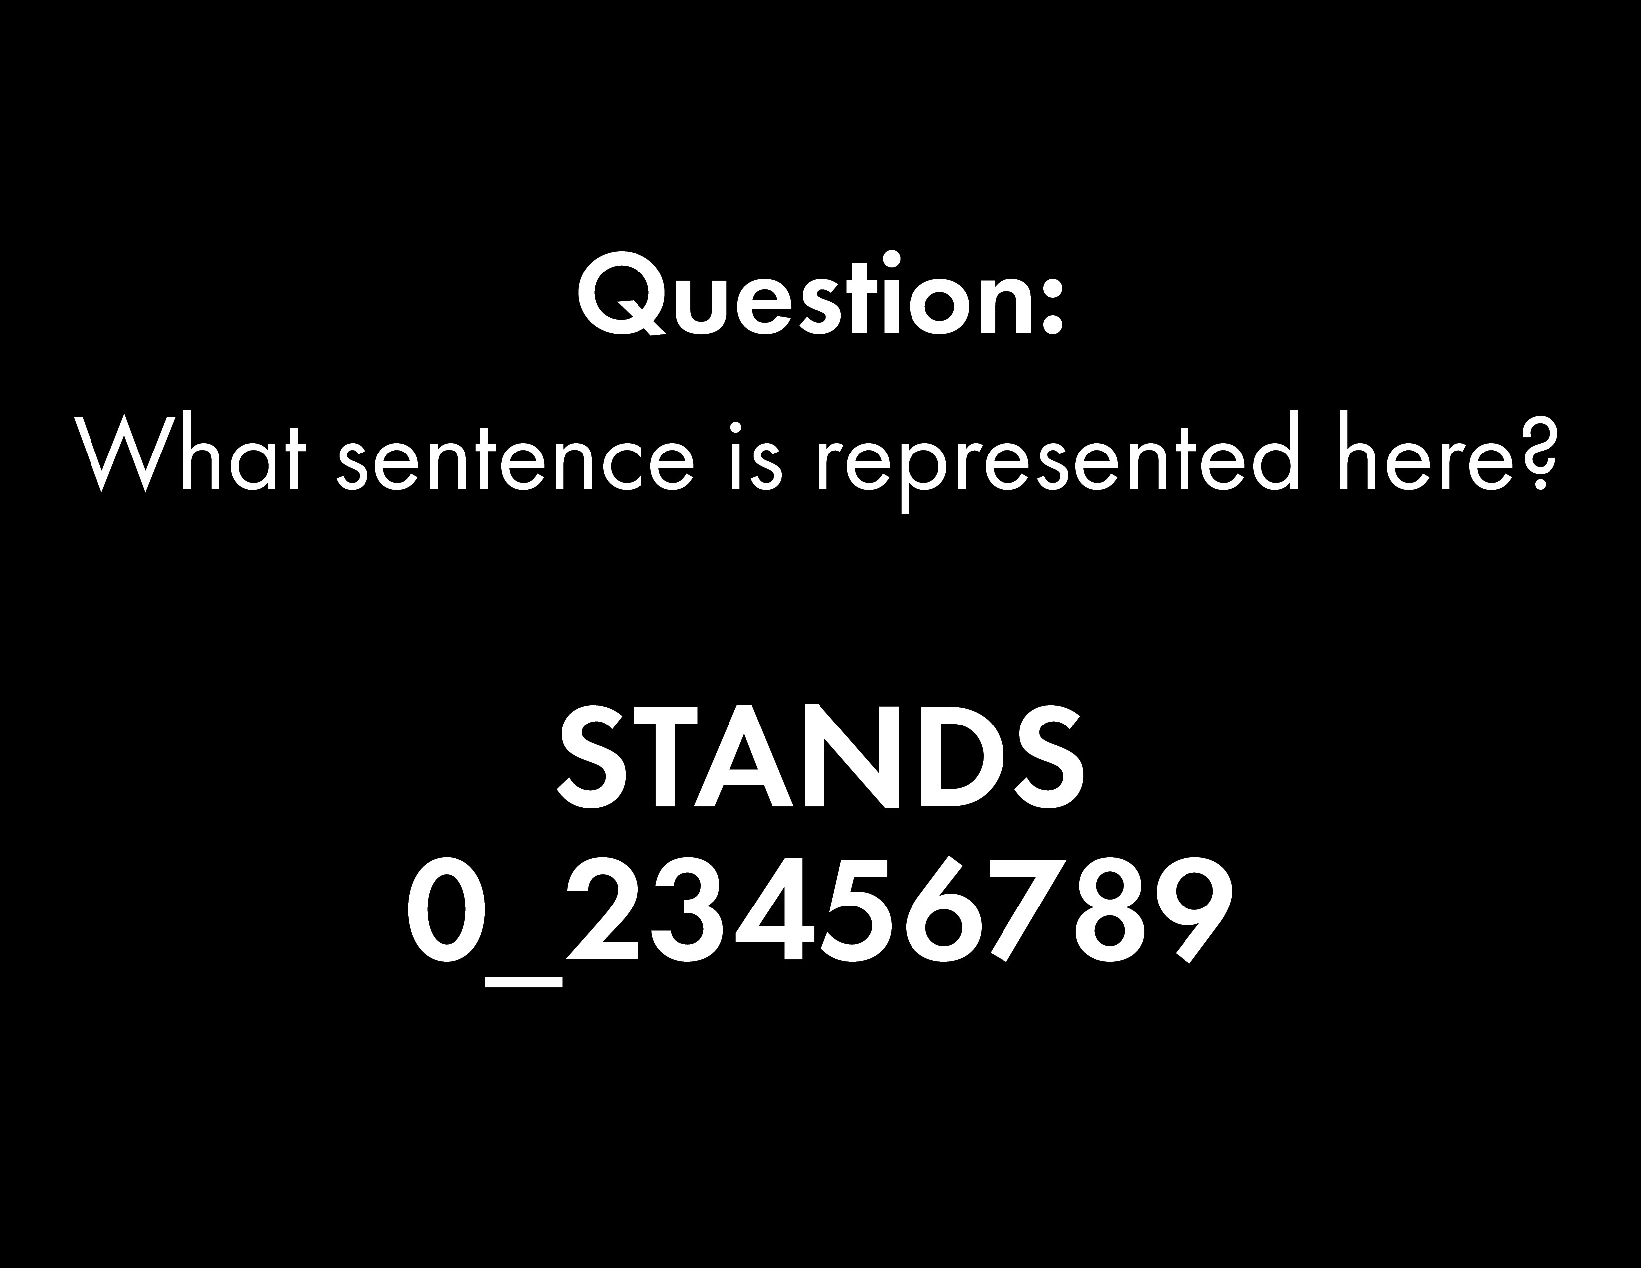

Slide 7


Slide 8
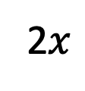
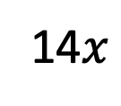



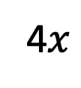



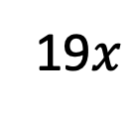




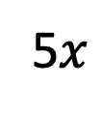
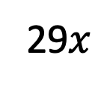


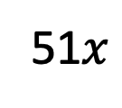
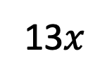
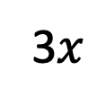
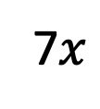



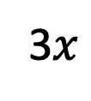




24
7
30
Algebraic Fractions
Date:
EQ – How do we add and subtract algebraic fractions with different denominators?
Now Your turn
Write the following as a fraction in its simplest form.
4$x$
2$x$
Solution
$x$
$x$
$x$
19$x$
[a]
$+$
$=$
$+$
$=$
We do
[e]
3
9
9
8
3
24
$x$
$x$
3$x$
3$x$
$x$
11$x$
[b]
$−$
$=$
[f]
$−$
$=$
2
8
8
4
5
20
$x$
$x$
$x$
2$x$
51$x$
5$x$
$x$
13$x$
$=$
[c]
$−$
$=$
$=$
[g]
$−$
$=$
12
4
6
24
54
6
9
18
7$x$
3$x$
2$x$
$x$
$x$
14$x$
29$x$
$=$
[d]
$+$
$=$
[h]
$+$
$=$
20
10
4
40
7
5
35
Notes:
For higher ability classes this slide could be easily skipped and instead the lesson could start as follows. I recommend teaching as:
Ex1 – Teacher walkthrough.
Ex2 – Teacher half-walkthrough, students finish.
Ex3 – Students attempt.
Ex4 – Teacher walkthrough.
Ex5 – Teacher half-walkthrough, students finish.
Ex6 – Students attempt.
Continue with lesson as normal.

Slide 9
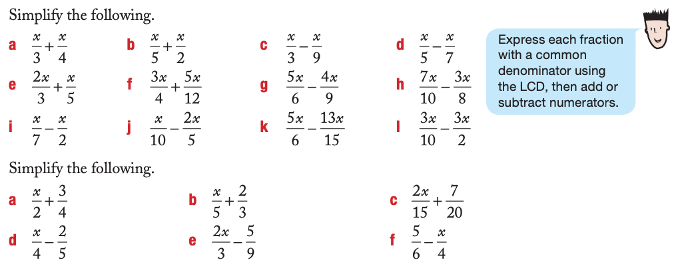
We do
Understanding

Slide 10
Notes Review
24, 7 ,30
Date
Title
Essential question
Notes complete
Notes complete with colour and diagrams
Questions completed
Contents page filled in
Formula page filled in

Slide 11
Homework
Review your notes, finish any unanswered questions and write a summary answering the Essential Question.

